Slide 1
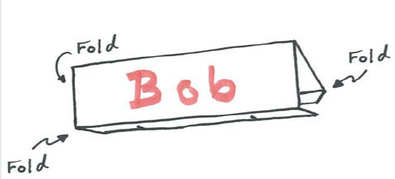
As you arrive, please make a name tent.
Figure 1. Name tent instructions. From https://kb.mit.edu/confluence/pages/viewpage.action?pageId=152584661
The name you would like to be called
Your pronouns, if you choose
Decorations, if you choose

Slide 2
Becoming Expert Learners: Teaching Students How Learning Works
Michelle Blank, Director of Academic Success, Goshen College
mblank@goshen.edu

Slide 3
The Plan for Our Journey
Figure 2. Wooded path. Retrieved from https://www.guideposts.org/better-living/health-and-wellness/living-longer-living-better/5-spiritual-lessons-from-lifes-trail
What: Concepts and Strategies to Help Students Become Better Learners
Why: “College students prefer to use suboptimal learning strategies when they study” (Chew 2024)
How:
Engaging Drew
Brain Files
Bloom’s
Retrieval Practice
Spaced Practice
Notes:
Brains don’t like surprises!

Slide 4
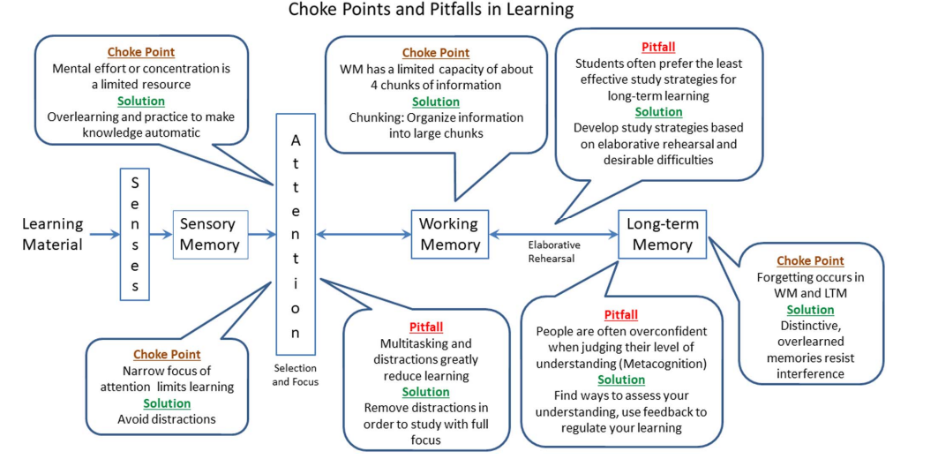
Figure 3. Memory and learning graphic organizer. From Chew, S. L. (2021). An advance organizer for student learning: Choke points and pitfalls in studying. Canadian Psychology/Psychologie Canadienne, 62(4), 420–427. https://doi.org/10.1037/cap0000290
Notes:
Effective study involves- Studying with full focus and minimal distractions; Studying using effective learning strategies; Assessing one’s level of understanding to identify confusions, gaps, and misconceptions.

Slide 5
Concept 1:
Engaging Drew

Slide 6
Figure 4. Memory and learning graphic organizer. From Chew, S. L. (2021). An advance organizer for student learning: Choke points and pitfalls in studying. Canadian Psychology/Psychologie Canadienne, 62(4), 420–427. https://doi.org/10.1037/cap0000290

Slide 7
System 1 Thinking
Fast
Automatic
Emotional
Unconscious
Figure 5. Black and white icon of multitasking. Retrieved from htt
ps://www.cleanpng.com/free/multitasking.html

Slide 8
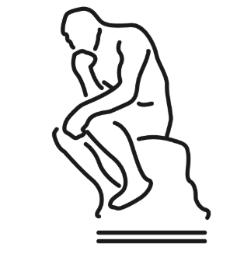
System 2 Thinking
Slow
Effortful
Logic
Conscious
LEARNING!
Figure 6:Black and white Icon of the thinker statue Retrieved from https://www.symbols.com/symbol/the-noun-project.

Slide 9
What are YOU doing
to Engage Drew?
(TWPS)

Slide 10
Using This Strategy
2- Column Notes
Concept Maps
Teaching Others
?
Answer(s)
Figure 7. 2-column notes
Figure 8. Black and white concept map icon. From https://thenounproject.com/icon/mind-map-5322826/
Figure 9. Black and white teacher and students icon. From https://thenounproject.com/icon/teach-5486510//

Slide 11
How I Teach This…
ABC/321
Asking “How are we engaging Drew?” (Every Class)
Muscle Memory examples
Inspected Practice

Slide 12
Let’s Practice…
Figure 10 Black and white icon of multitasking. Retrieved from htt
ps://www.cleanpng.com/free/multitasking.html
Figure 11.:Black and white Icon of the thinker statue Retrieved from https://www.symbols.com/symbol/the-noun-project.

Slide 13
Concept 2:
Brain Files

Slide 14
Figure 12. Memory and learning graphic organizer. From Chew, S. L. (2021). An advance organizer for student learning: Choke points and pitfalls in studying. Canadian Psychology/Psychologie Canadienne, 62(4), 420–427. https://doi.org/10.1037/cap0000290

Slide 15
Figure 13. Head with file folders. From https://www.scribd.com/doc/61773162/Schema-Poster

Slide 16
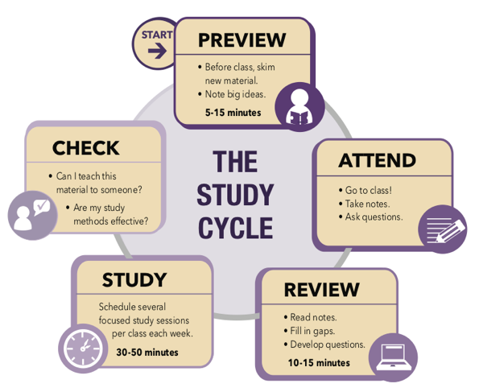
Using This Strategy
Reading BEFORE Class
Study Cycle
“Open your file on…”
Figure 14. Black and white reading icon. From https://thenounproject.com/icon/studying-1475748/
Figure 15. Study cycle. From https://www.lsu.edu/cas/studycycle.php
Figure 16. Black and white person with speech bubble icon.. From https://thenounproject.com/icon/person-talking-1691905/

Slide 17
How I Teach This…
Role Play
Concrete Examples
Every Class Reminders
Inspected Practice

Slide 18
Concept 3:
Bloom’s Levels

Slide 19
Figure 17. Memory and learning graphic organizer. From Chew, S. L. (2021). An advance organizer for student learning: Choke points and pitfalls in studying. Canadian Psychology/Psychologie Canadienne, 62(4), 420–427. https://doi.org/10.1037/cap0000290

Slide 20
Count the Vowels
How accurate are you? 30 seconds…

Slide 21
Dollar Bill
Dice
Tricycle
Four-leaf Clover
Hand
Six-Pack
Seven-Up
Octopus
Cat Lives
Bowling Pins
Football Team
Dozen Eggs
Unlucky Friday
Valentine’s Day
Quarter Hour

Slide 22
What are we focusing on?
What are the patterns?
How is the information organized?
What’s the level of difficulty?
How many words can you remember? 30 seconds…

Slide 23
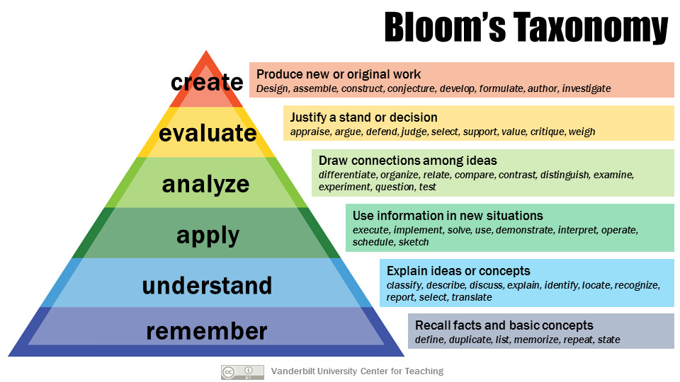
Figure 18. Bloom's taxonomy. From https://cft.vanderbilt.edu/guides-sub-pages/blooms-taxonomy/

Slide 24
Figure 19. Goldilocks questions at Bloom’s levels.

Slide 25
Using This Strategy
Class | Assignment | Highest Level | Reason
Academic Voice | Essay 3 | Creating | This is creating because I have to come up with my own ideas to answer the research questions and craft those into a persuasive essay and speech. In the research phase I have to analyze and evaluate my sources to decide which ones I should include. I have to be at the understanding phase as I read the research since I'm trying to make meaning from the material.

Slide 26
Using This Strategy
Class | Assignment | Highest Level | Reason
Accounting 3 | Exam 3 | Creating | Remembering- the definitions of the terms and the formulas Understanding- making meaning of the scenario provided on the exam Applying- taking the concepts I learned in class and using them to help resolve the problem in the scenario Analyzing- looking at each part of the problem in the scenario to figure out how to resolve it Evaluating- deciding which strategies would work best in this particular case Creating- come up with my own solutions to the problem.

Slide 27
How I Teach This…
Count the Vowels
Blooms Applications
Add to the What, Why, How
Inspected Practice

Slide 28
Let’s Practice…
Figure 19. Black and white teacher and students icon. From https://thenounproject.com/icon/teach-5486510//
Figure 20. Head with file folders. From https://www.scribd.com/doc/61773162/Schema-Poster

Slide 29
Concept 4:
Retrieval Practice

Slide 30
Figure 21. Memory and learning graphic organizer. From Chew, S. L. (2021). An advance organizer for student learning: Choke points and pitfalls in studying. Canadian Psychology/Psychologie Canadienne, 62(4), 420–427. https://doi.org/10.1037/cap0000290

Slide 31
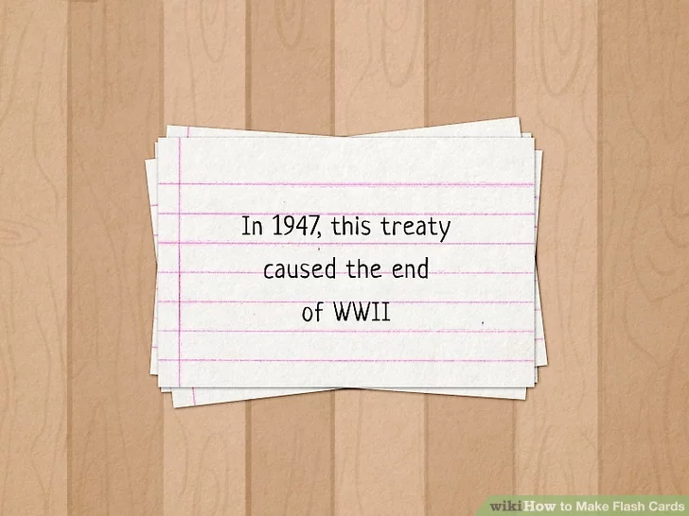
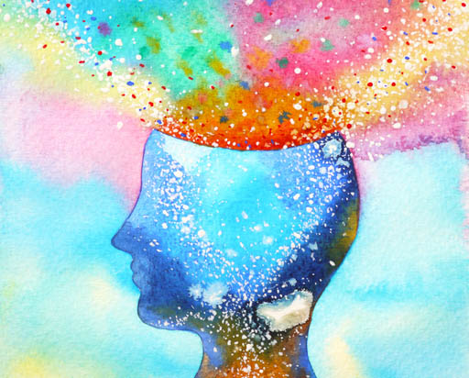
Using This Strategy
Self-Quizzing
Teaching
Others
Figure 22. Flashcards. From https://www.wikihow.com/Make-Flash-Cards
Figure 23. Black and white teacher and students icon. From https://thenounproject.com/icon/teach-5486510//
Study Groups
Brain Dump
Figure 24. Black and white group icon. From https://thenounproject.com/icon/users-6443100/
Figure 25. Colorful head with ideas flowing out. From https://www.neverdefeatedcoaching.net/the-power-of-a-brain-dump-how-to-untangle-your-adhd-mind/

Slide 32
How I Teach This…
What is Retrieval? (Concrete Example)
Muscle Memory examples
Lack of Practice examples
Inspected Practice

Slide 33
Concept 5:
Spaced Practice

Slide 34
Figure 26. Memory and learning graphic organizer. From Chew, S. L. (2021). An advance organizer for student learning: Choke points and pitfalls in studying. Canadian Psychology/Psychologie Canadienne, 62(4), 420–427. https://doi.org/10.1037/cap0000290

Slide 35
5-Day Study Plan
Break info into 4 parts- starting with earliest (Part A)
Day 5 before the test- Study Part A for 30 minutes/ 30 minutes
Day 4 before the test- Study Part B for 30 minutes/ 30 minutes and Part A for 30 minutes (self-quiz)
Day 3 before the test- Study Part C for 30 minutes/ 30 minutes, Part B for 30 minutes, (self-quiz) and Part A for 20 minutes (self-quiz)
Day 2 before the test- Study Part D for 30 minutes/ 30 minutes, Part C for 30 minutes (self-quiz), Part B for 20 minutes (self-quiz), and Part A for 20 minutes (self-quiz)
Day before the test- Review all parts in two 30-minute sessions (more if needed) THEN rest and relax
Take short breaks (5-10 mins) between parts

Slide 36
How I Teach This…
5-Day Study Plan
Explain “Forgetting”
Lack of Practice examples
Inspected Practice

Slide 37
Reflection:
What small thing can you change to move students toward becoming expert learners?

Slide 38
Resources
Chew, S. L. (2021). An advance organizer for student learning: Choke points and pitfalls in studying. Canadian Psychology/Psychologie Canadienne, 62(4), 420–427. https://doi.org/10.1037/cap0000290
Chew, S. (2021). Improving study skills through psychological science [Google Slides]. American Psychological Association. https://docs.google.com/presentation/d/16wx76eLZctYZMUnqsL-qoGKFlYlZl1R6fip-Naz6hBI/edit#slide=id.g5e378fe58b_2_75
Chew, S. (2024). Teaching students how to study. Retrieved from https://www.teachingprofessor.com/topics/student-learning/study-strategies/teaching-students-how-to-study
Gurung, R. A. R., & Dunlosky, J. (2023). Study like a champ : the psychology-based guide to “grade a” study habits. American Psychological Association.
Kahneman, D. (2011). Thinking, fast and slow (1st ed.). Farrar, Straus and Giroux.
Kirschner, P.A., & Hendrick, C. (2020). How learning happens: Seminal works in educational psychology and what they mean in practice (1st ed.). Routledge. https://doi.org/10.4324/9780429061523
McGuire, S. Y., & McGuire, S. (2015). Teach students how to learn : strategies you can incorporate into any course to improve student metacognition, study skills, and motivation (First). Stylus Publishing, LLC.
Willingham, D. T. (2023). Outsmart your brain : why learning is hard and how you can make it easy (First Gallery Books hardcover). Gallery Books, an imprint of Simon & Schuster.

